Slide 1
EYFS Curriculum 2022-23
Jess Tolson

Slide 2
Intent
At Firfield Primary School we believe that all children deserve the best possible start to their school life in order to enable them to reach their full potential. Therefore, we strive to provide an ambitious and engaging EYFS curriculum which allows the children to develop as individuals and become well-rounded world citizens. Throughout the year, the children will develop knowledge and skills to enable them to think critically and creatively, and begin their journey to becoming resilient, independent learners. We will deliver an EYFS curriculum which is accessible to all children, regardless of their level of development or SEND.

Slide 3
EYFS Curriculum at Firfield
Primary Knowledge Curriculum (PKC)
Essential Letters and Sounds
White Rose Maths
Get Set 4 PE
Charanga
Knowledge rich
Ambitious
Sequential – builds on knowledge throughout the school
Consistency across the school

Slide 4
Implementation
Our long term plan is based on the curriculum map set out by the Primary Knowledge Curriculum (PKC). This is followed throughout the school, and provides an excellent foundation of knowledge for pupils within EYFS, which is then built upon as they progress through school. The curriculum is carefully planned and sequenced to ensure that knowledge and skills are broken down into small steps, whilst still maintaining an element of desirable difficulty. Thus ensuring that the children are appropriately challenged in order to make good progress in line with their developmental needs.
The curriculum in EYFS is a challenging and exciting one, which follows a topic-based approach, in which all aspects of the curriculum are interlinked. This allows us to provide a rich and stimulating curriculum that is holistic and enables the children to make links between what they are learning and build upon skills and knowledge that they have already mastered.

Slide 5
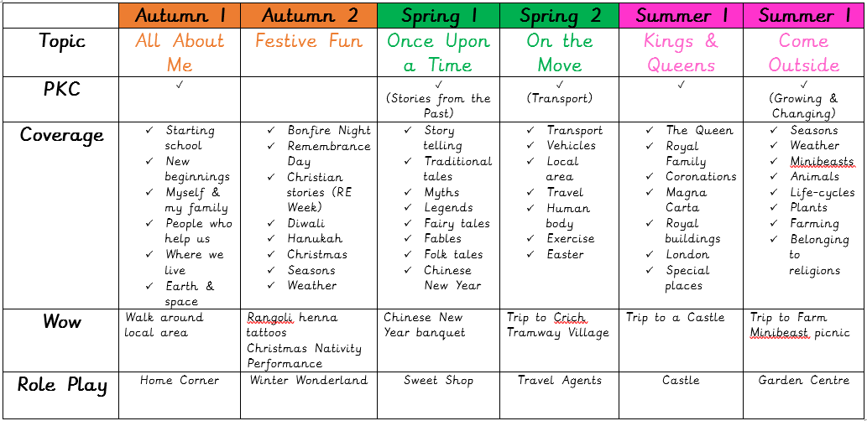
Curriculum map

Slide 6
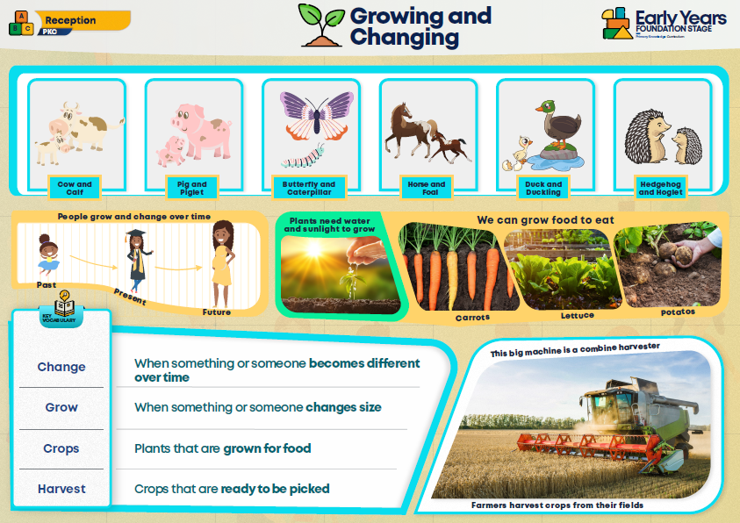
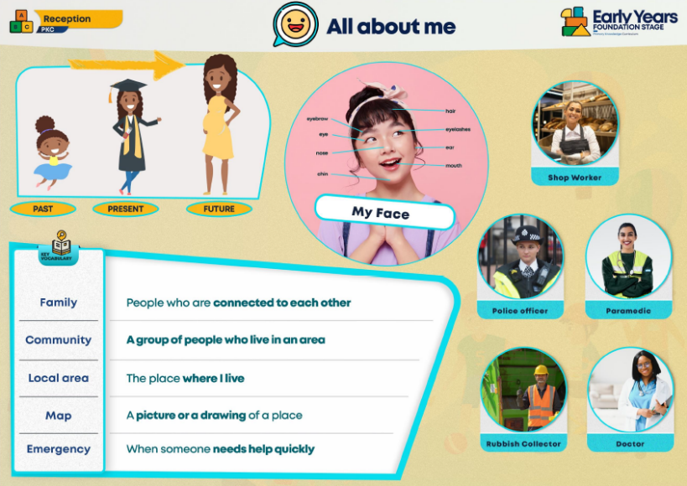
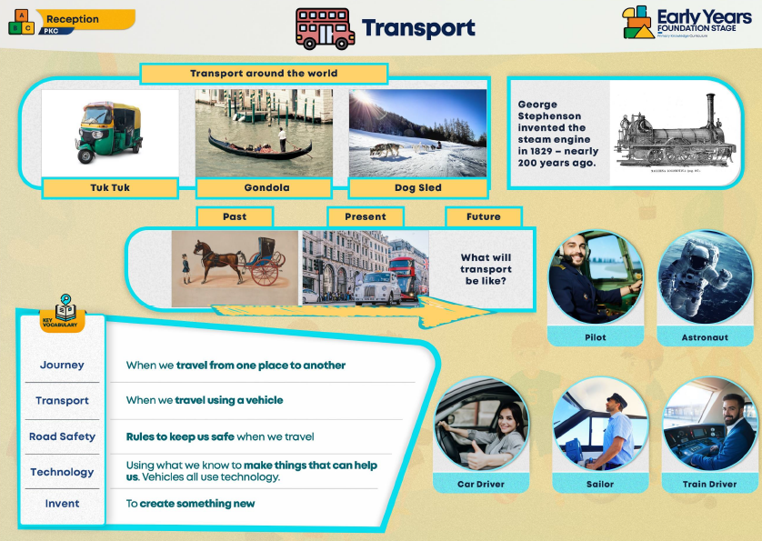
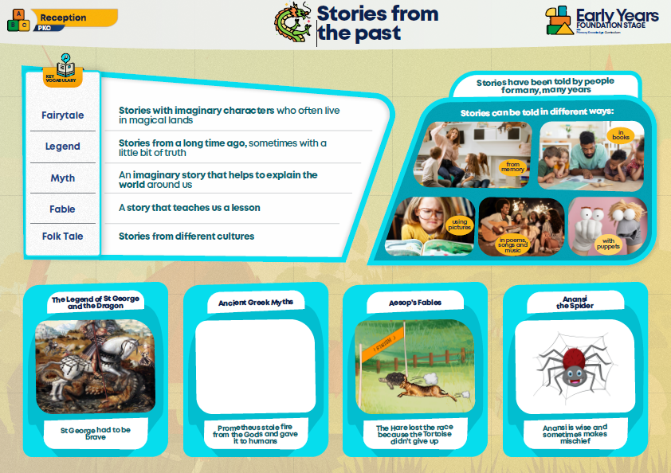
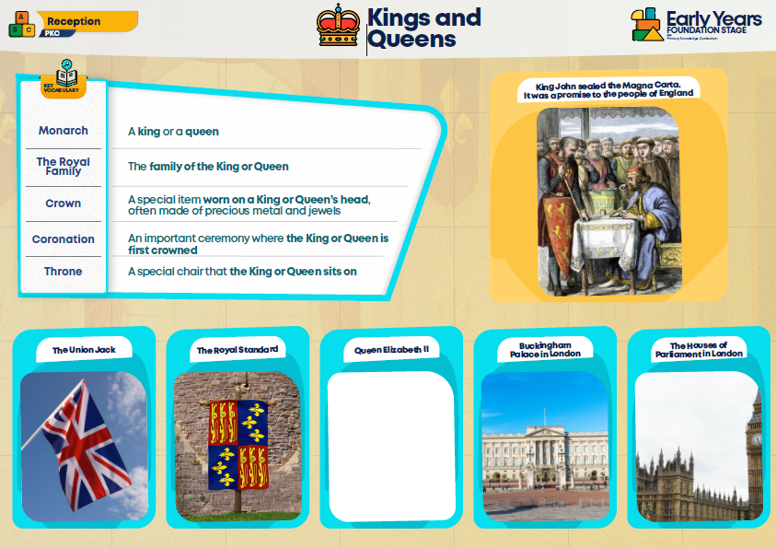
Knowledge
Organisers

Slide 7
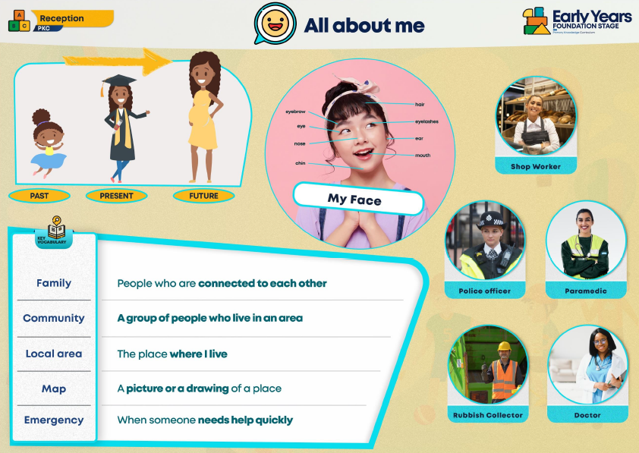
Knowledge Organisers

Slide 8
Areas of Learning
The Prime Areas are:
Communication and Language
Physical Development
Personal, Social and Emotional Development
The children are also supported in the four Specific Areas, through which the three Prime Areas are strengthened and applied.
The Specific Areas are:
Literacy
Mathematics
Understanding the World
Expressive Arts and Design

Slide 9
Characteristics of Effective Learning
The ‘Characteristics of Effective Teaching and Learning’ are the ways in which our children engage with other people and their environment. They are:
Playing and exploring - children investigate and experience things, and ‘have a go’
Active learning – children concentrate and keep on trying if they encounter difficulties, and enjoy achievements
Creating and thinking critically – children have and develop their own ideas, make links between ideas, and develop strategies for doing things
They underpin learning and development across all areas and support our children to remain an effective and motivated learner.

Slide 10
Curriculum Delivery
Explicit, whole class teaching sessions
Small group, adult-led activities
Learning through play
Indoor and outdoor classroom environments
1:1 interventions

Slide 11
Recording
No expectation to record in EYFS
Purple books
  Knowledge Organisers
  Curriculum
  Photos
  Children’s recordings
  Art work
Blue books – independent writing
Pink books – mark making
Phonics booklets
Tapestry – Wow Moments

Slide 12
Assessment
Formative – daily, on-going
Summative – Insight – 4 times a year
Baseline → 3-4yrs (Development Matters)
Autumn 2 → Reception Year
Spring 4 → Reception Year
Summer 6 → Early Learning Goals

Slide 13
Impact
At Firfield Primary School, the children in EYFS will demonstrate high levels of engagement in both child-led and adult-led activities. By developing speaking and listening skills, we are enabling the children to be confident communicators, who can articulate their needs and learning. We strive to develop determination, resilience and perseverance when tackling challenges and more difficult learning, allowing every child to flourish and thrive. The children will develop a sense of the wider world and draw on their own experiences to make links with their learning. They will also be able to apply their knowledge and understanding to a range of situations.
By the end of the EYFS, children will have made good progress from their starting points, therefore achieving a Good Level of Development, and many of the Early Learning Goals. Children will transition into Year 1 with key knowledge and overarching concepts to enable them to access the requirements of the National Curriculum. They will leave EYFS with the best foundations to prepare them for a life-long learning journey, helping them to live happy and successful lives that are both fulfilling and rewarding.

