Slide 1

Using Knowledge Organisers
How you can use Knowledge Organisers at home to help with your child’s learning.

Slide 2

Powerful Knowledge
At Firfield, we place powerful knowledge – that’s knowledge that takes our children beyond their own experiences – at the very heart of our curriculum.
When developing our curriculum, we have thought meticulously about what we teach using the latest findings that help us to ensure that the knowledge we teach your children is remembered.
We want to teach our children the very best of what has been thought and said. We select and teach powerful knowledge that children can think with, critique and ultimately improve upon.
Skills and knowledge are intrinsically linked. We ensure that our children develop subject specific skills and understand what it is to be a really good historian, geographer, scientist, artist etc. and how to be one themselves.

Slide 3

Sequenced
Another really key element of our curriculum at Firfield is the sequencing of learning. We sequence our learning in a meaningful way that enables our children to make really good progress each year.
With each lesson and every unit building towards this big picture, we help the children to make connections between things they’ve learnt in the past, things they’ve learnt in different subject and the wonderful things that they learn outside of school too.

Slide 4

Subject disciplines
At Firfield, we recognise and promote the identify of the individual subjects we study. We aim to foster a love for subjects which will flourish as they progress through the curriculum and beyond.
We want them to know what it is to be a historian or a scientist, and to develop the background knowledge and disciplinary skills to become historians, artists, designers, scientists and geographers of the future.

Slide 5

A curriculum for all
As an inclusive school, ensuring our curriculum is diverse and inclusive has always been a priority for us at Firfield. We strive to ensure that our curriculum has a balanced representation of disability, faith, class, race, gender, heritage and culture.
We believe that a rich curriculum is the entitlement of every child. Therefore, our curriculum aims to provide all children with the knowledge they need to succeed in whatever they want to do in the future and in an ever changing world.

Slide 6
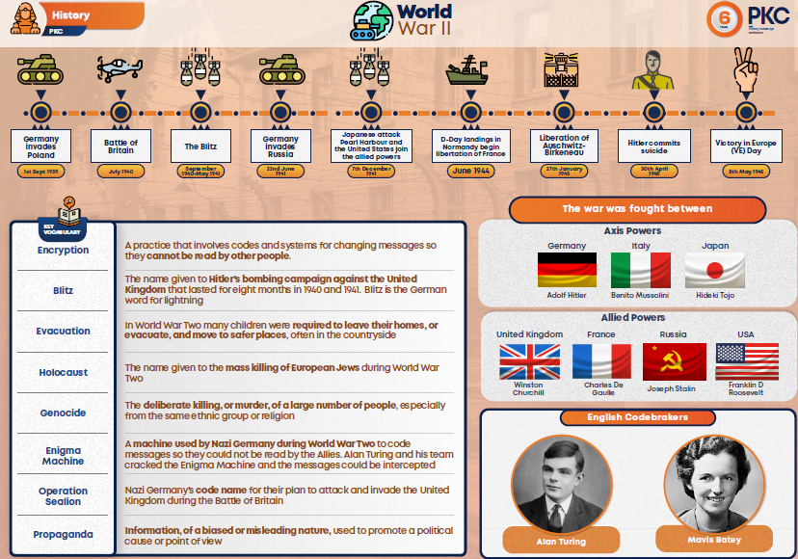
What is a knowledge organiser?
An knowledge organiser is a 1 page sheet of A4 paper that is full of the key factual knowledge that we want our children to use and remember such as the names of the key people being studied, key events and dates, key people and key vocabulary that we want our children to use and understand.
Everything on the knowledge organiser is quizible. We encourage our staff to use and refer to the knowledge organiser in every lesson.
Here is an example knowledge organiser from our History Curriculum.

Slide 7
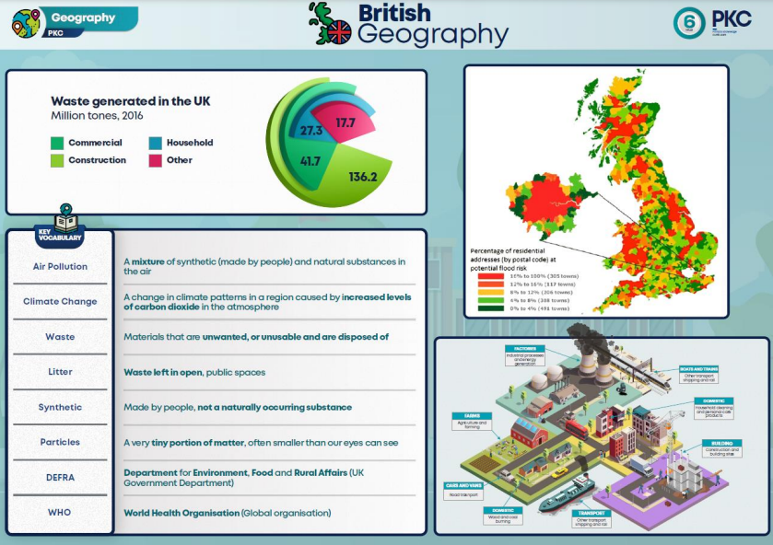
How are knowledge organisers used in school?
One of the things we do with our knowledge organisers is to blank out key information and ask the children what is missing. See here on the right.
The more they see them and use them, the more familiar they will become. Also, key knowledge is more likely to stick in the children’s minds.
We know from findings from cognitive science that quizzing is a key tool in helping children to learn.
In school, we also them as a springboard to answer questions that require more complex thought and more depth of knowledge such as ‘Why did this event happen?’ and ‘What were the consequences of this in the short and long term?’
Knowledge organisers will also really help children to develop their vocabulary.

Slide 8
How can you use knowledge organisers at home?
Talk to you child about their knowledge organiser.
  It can be a great springboard to talk about what they’re learning about at school.
  What do you know about this person on the knowledge organiser?
  Have they seen this piece of artwork before in class? Do you like it? Why/why not?
  Remember, if you look at the knowledge organiser at the beginning of the half term, they are unlikely to have learnt much on there yet.
Display it somewhere they can see it regularly.
  The more the children see it and interact with it, the more they are likely to remember it.
Quiz your child
  Ensure this is done in a fun and supportive way.
  Celebrate learning.
  What is the source of a river? What is the difference between a rural and urban setting.

Slide 9
For more information about our curriculum, please see our school website or contact Mr Thurgood.

